Slide 1
NARRATIVES WITH YARN
and also unity
by miles

Slide 2
“If you get lost. . . “
https://github.com/YarnSpinnerTool/YarnEditor
^ This is the yarn spinner editor!
https://docs.google.com/document/d/1nQaADlT3vfrH-mpeIzlyIFZxRBQA56bpMgSw5O4zLBs/edit?usp=sharing
^ this is my guide to writing in the yarn editor! I also have a section with every link I have.
https://github.com/YarnSpinnerTool/YarnSpinner/blob/master/Documentation/YarnSpinner-Dialogue/Yarn-Syntax.md
^this is Yarn’s Guide to Writing in the yarn editor! Includes online stuff!
https://github.com/YarnSpinnerTool/YarnSpinner/blob/master/Documentation/YarnSpinner-Unity/YarnSpinner-with-Unity-StepByStep.md
^ this is Yarnspinner’s primer for using Yarn + Yarnspinner!
Notes:
I also just put links everywhere

Slide 3
Presentation Format
Open my demo & run the basic example
Look at the component parts of yarnspinner
Start working on the Demo Scene
Look at the Stanley Parable Script in Merino
Create a new font with TMPro
Create a 2D Particle System Prefab
Create our Dialogue UI
Create a Command that generates our Particles and add it to the script
4-5
6-8
9-10
11
12
13
14
15 -6
Notes:
Ask who wants to participate and do smuga / scalera style

Slide 4
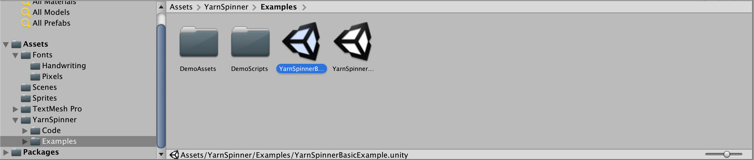
OPEN THE FILE
Ignore the complex example [for now]
If you play it, you should see characters A and B talking
You are then given a choice

Slide 5
What you start with:
Basic Concepts
Dialogue Appears
You can click to advance it
You can pick from a list of choices.
What is needed for that:
Dialogue Runner
Dialogue UI
Variable Storage
Notes:
Run the Basic Example and the Complex Example

Slide 6
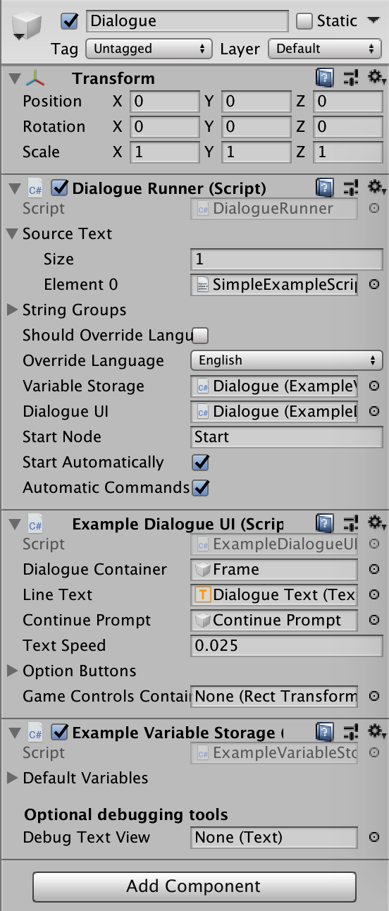
Dialogue Runner
This is an GameObject with attached scripts!
Source Text: the file(s) containing your yarn dialogue
String Groups: The group of JSON files to be used for this language [don’t always need this]
Variable Storage: from the other attached script
Dialogue UI: from the other attached script
Example Variable Storage: from the other attached script

Slide 7
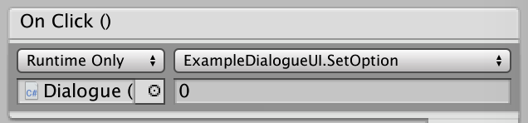
Dialogue UI
Where the parsed script gets sent for display - and how the text is displayed
Overrides the: RunLine, RunOptions, RunCommand, DialogueStarted, and DialogueComplete coroutines
All exist in Yarn.Unity.DialogueUIBehaviour
Can also include additional UI features and custom options!
This also includes the button prompt!

Slide 8
Variable storage
Yarn scripts can create and use variables to determine different user paths, and unity can use these variables to do different things
Path from Yarn to Unity - it could be used to set or get a variable in the written script
You cannot access arbitrary c# variables - one way street
For our purposes today, we don’t need to go into it, but you can go in and customise!
Notes:
For example, in my final game, i want specific drinks to effect the other character’s reaction to the drink - this will be done through a score variable

Slide 9
Now to make our game!

Slide 10
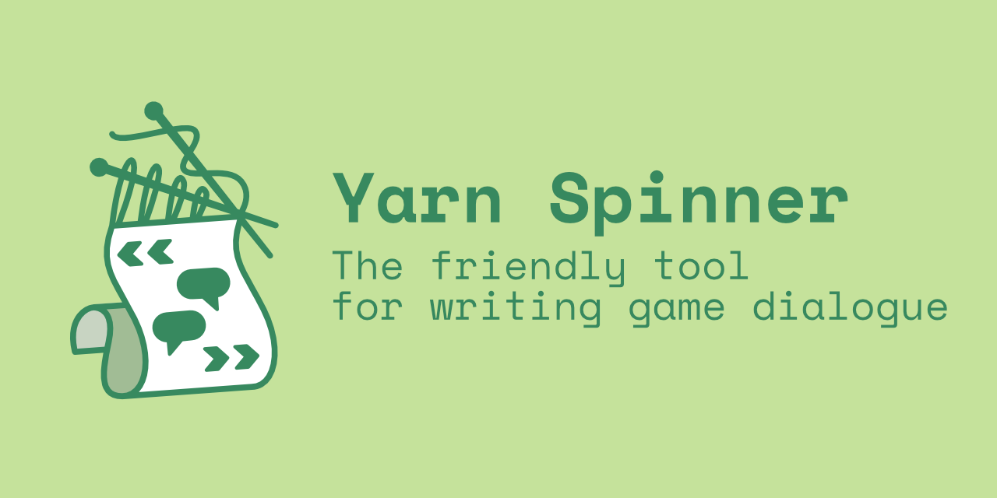
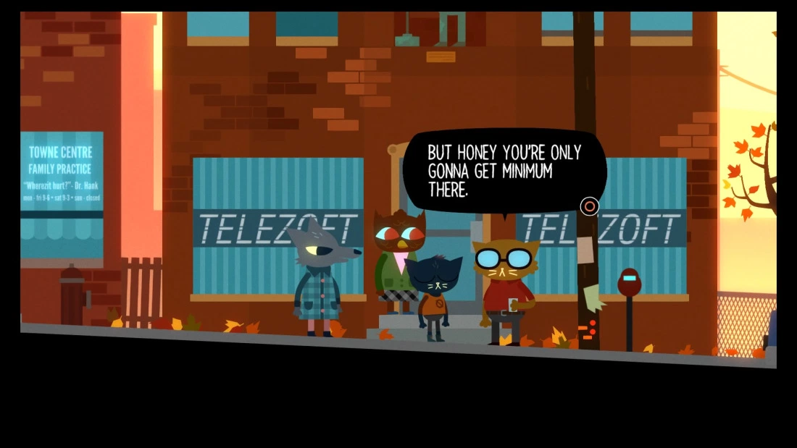

Writing a Script
https://docs.google.com/document/d/1nQaADlT3vfrH-mpeIzlyIFZxRBQA56bpMgSw5O4zLBs/edit?usp=sharing
https://github.com/YarnSpinnerTool/YarnSpinner/blob/master/Documentation/YarnSpinner-Dialogue/README.md
https://github.com/YarnSpinnerTool/YarnSpinner/blob/master/Documentation/YarnSpinner-Dialogue/Complex-Dialogue-Tutorial.md
Yarn has its own syntax, and I have a document and a lot of links about how to write for it!
It’s a learn-as-you-go sort of thing, so I made a script based on the stanley parable

Slide 11
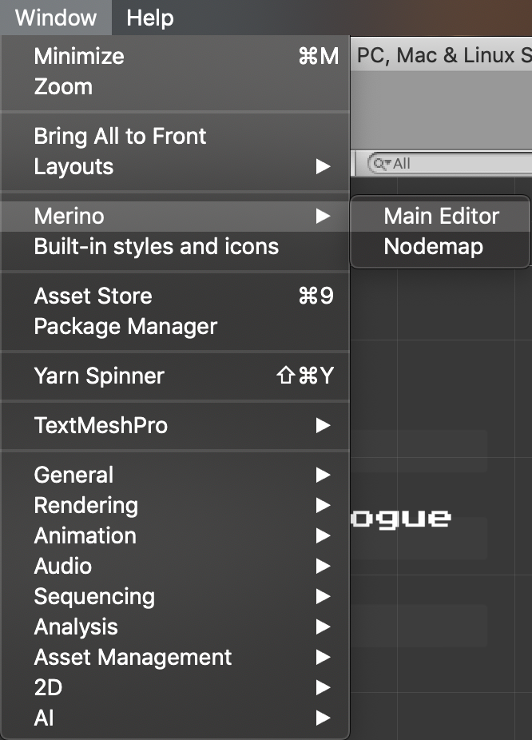
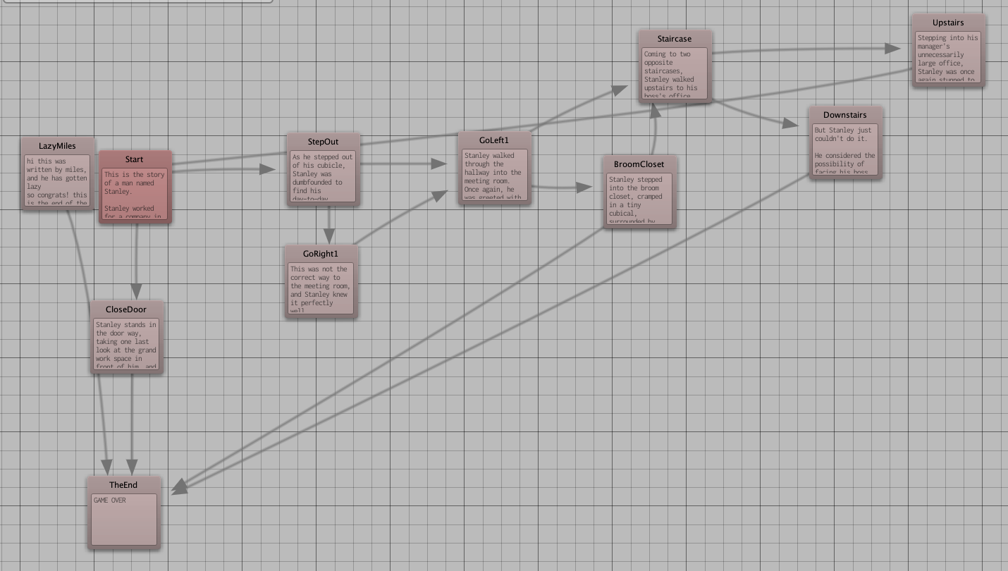
Merino / Yarnweaver
https://github.com/radiatoryang/merino
I included this because it is super useful!
You can edit your scripts right in the editor!

Slide 12
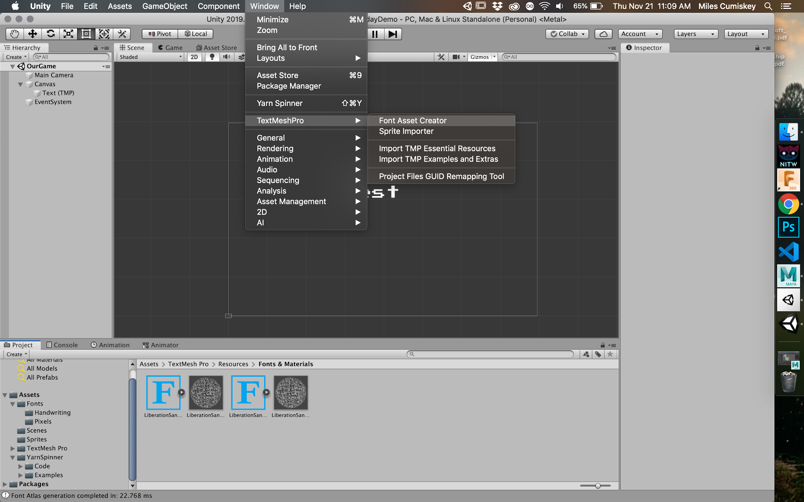
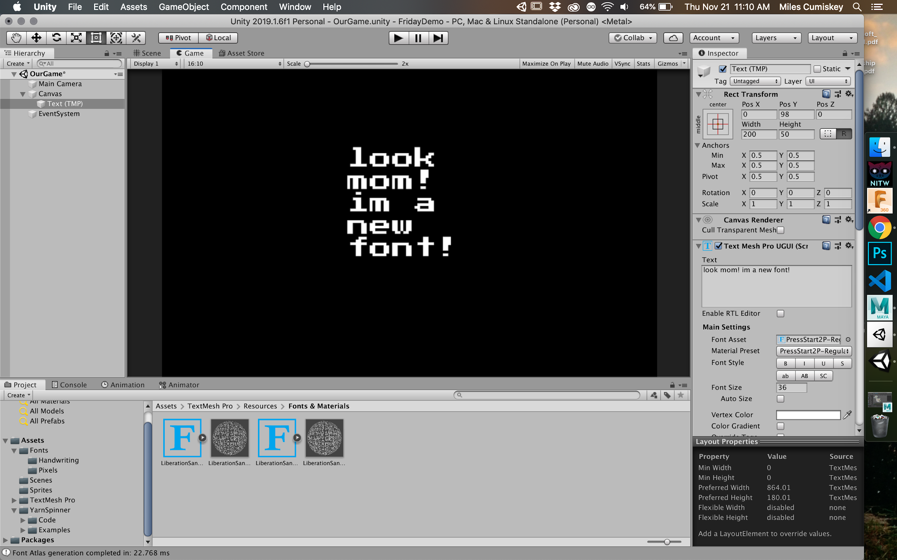
Text Mesh Pro
http://digitalnativestudios.com/textmeshpro/docs/font/
Window / TextMeshPro - Font Asset Creator
Select The font you want, hit ‘generate’ then save it in the fonts folder
Notes:
Have them follow this with the handwriting font

Slide 13
2D Particle System
Visual_Assets -> New Material
Put the ‘Confetti.png’ into the Albedo [] for the default material
Change Shader to Sprites -> Default
Creating the Particle System
Under the render drop-down, change the material to our confetti material
Go to Texture Sheet animation, set tiles to be 1 x 10 and Animation to be single row
From here, play with rotation + speeds for your ideal effect!
Notes:
Have everyone make confetti

Slide 14
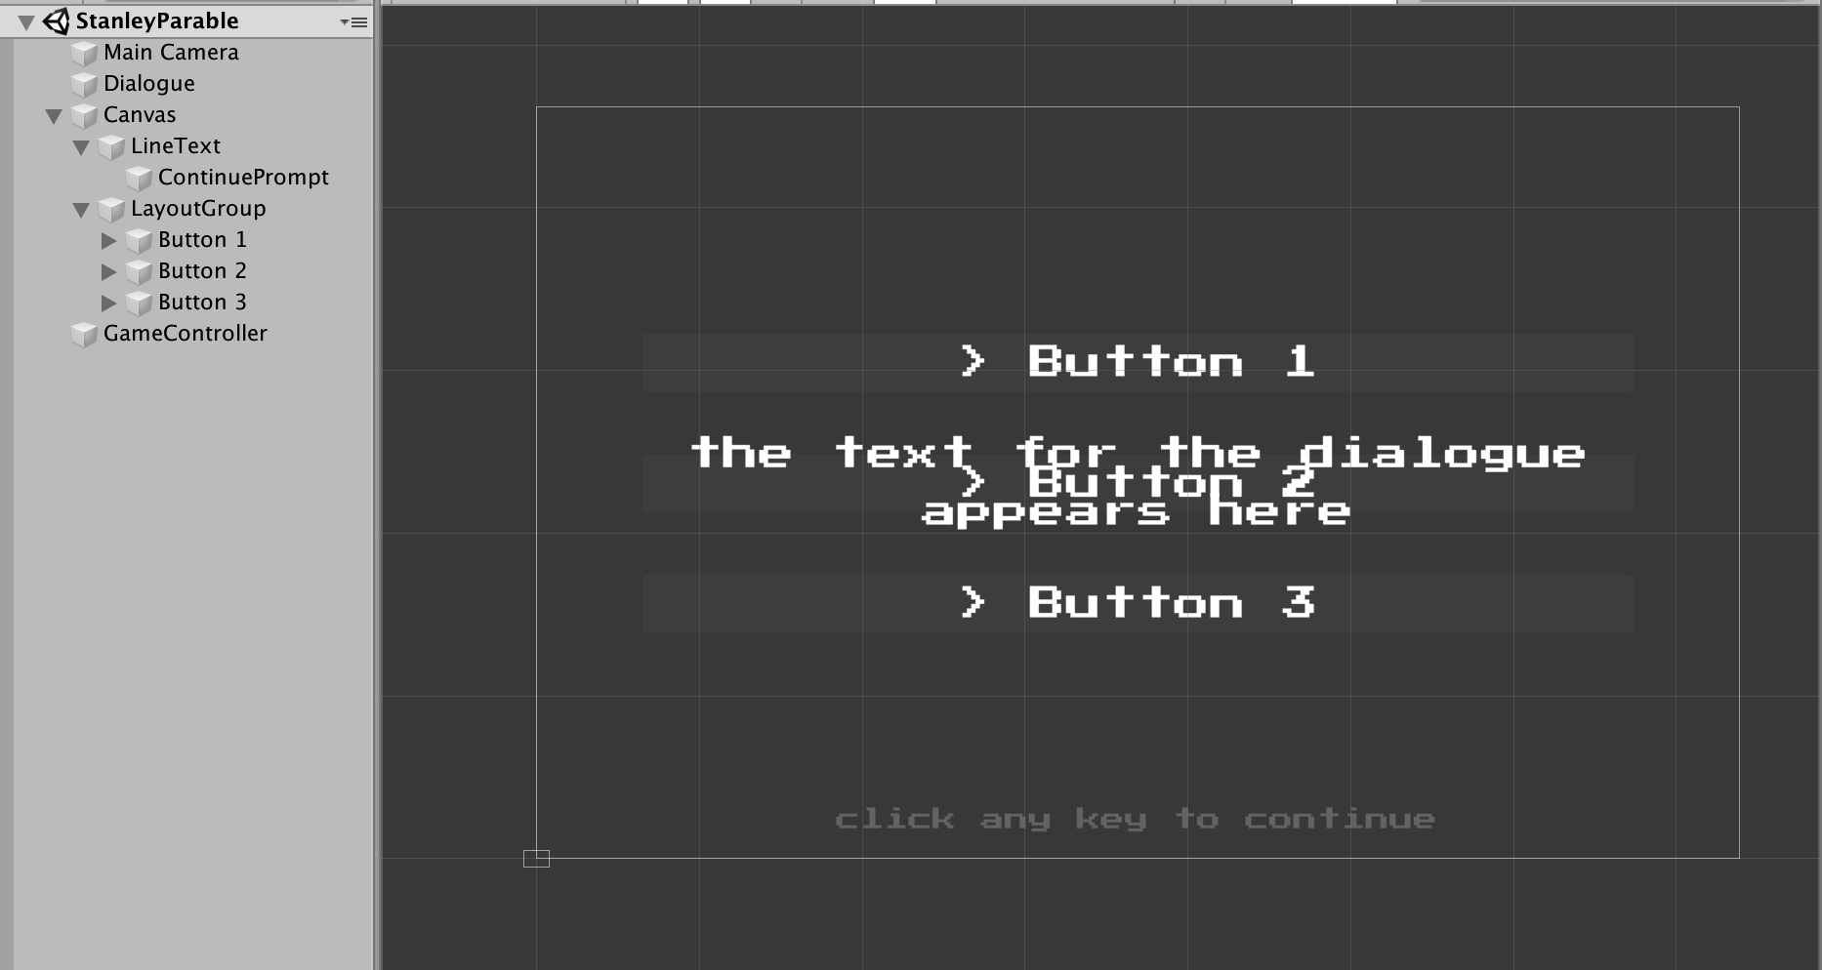
Our Dialogue System
For a basic game, we don’t need to edit the dialogue much
Change Text to TextMeshPro
You still want a gamecontroller
This is what we will attach the Yarn Commands to

Slide 15
Writing Commands
https://www.secretlab.com.au/blog/2017/11/14/how-night-in-the-woods-uses-yarn-spinner
Why do it?
change things directly from the text [buying an item, setting a variable, shaking the screen, etc]
How to do it:
Create a new C# Script
namespace Yarn.Unity.Demo
Attach this script to your GameController to add it to your scene

Slide 16
Command Creates Effect
public GameObject SpaceParticles;
/// Create a command and call it "generateParticles"
[YarnCommand("generateParticles")]
//the yarn command's effect is on the function underneath it
//all parameters MUST be strings
//The yarn function is called with <<CommandName GameObject StringParameters>>
//ie this is <<generateParticles GameController space>>
public void generateParticles(string particleName) {
//if the parameter is space
if(particleName == "space") {
//create the glitter prefab
Instantiate(SpaceParticles, new Vector3(0, 0, 0), Quaternion.identity);
} else {
//do nothing
}
}
Notes:
Go through this and add a new if for the Confetti System

Slide 17
How to use this in your game:

Slide 18
Open up the Complex Example
Shows a spriteswap command
Shows player movement and yarn script changes
NOW GO FORTH!
or ask questions we can do both

